Slide 1
Chapter Five
The Transport Layer

Slide 2
Objectives
The transport layer is responsible for process-to-process delivery of the entire message.
A process is an application program running on a host.
Whereas the network layer oversees source-to-destination delivery of individual packets, it does not recognize any relationship between those packets.
It treats each one independently, as though each piece belonged to a separate message, whether or not it does.
The transport layer ensures that the whole message arrives intact and in order, overseeing both error control and flow control at the source-to-destination level.

Slide 3
3.1 Introduction
the core or the heart of the whole protocol hierarchy
it provides reliable, cost-effective data transfer from the source to the destination on top of an unreliable network; process-to-process delivery
the transport layer code runs on the users’ machines; the network layer mostly runs on the routers (operated by a carrier for a WAN) and the adequacy of the service can not be guaranteed
position of the transport layer

Slide 4
Cont’d…
A transport layer protocol can be either connectionless or connection-oriented
A connectionless transport layer treats each segment as an independent packet and delivers it to the transport layer at the destination machine.
A connection-oriented transport layer makes a connection with the transport layer at the destination machine first before delivering the packets. After all the data is transferred, the connection is terminated

Slide 5
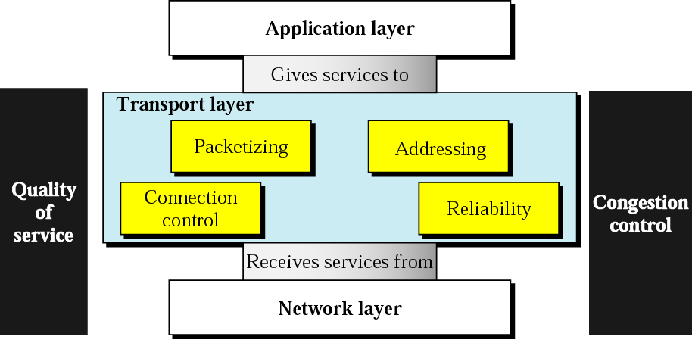

Slide 6
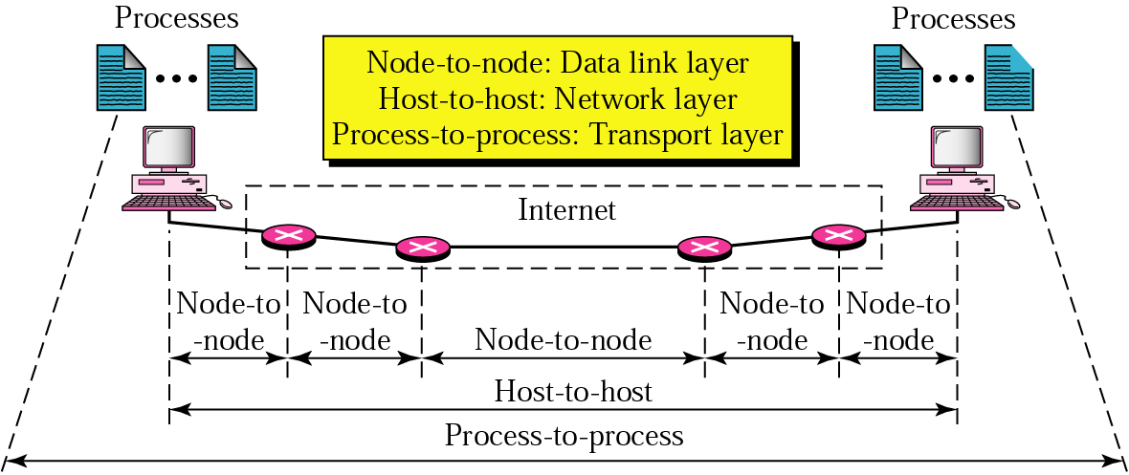
data link layer: node-to-node delivery
network layer: host-to-host delivery
transport layer: process-to-process delivery
several processes may be running on the source as well as the destination; an addressing mechanism is required (see next slide)

Slide 7
two processes communicate in a client-server relationship (paradigm)
a process on the local host, called a client, needs services from a process usually on the remote host, called a server
both processes (client and server) have the same name; e.g., to get the day and time from a remote machine, we need a Daytime client process running on the local host and a Daytime server process running on a remote machine
for communication, we must define (identify them by an addressing mechanism) the following four
Local Host
Local Process
Remote Host
Remote Process

Slide 8
3.2 Packetizing
the transport layer creates packets out of the message received from the application layer
it divides a long message into smaller ones; they are then encapsulated into the data field of the transport-layer packet and headers are added
3.3 Addressing
at the data link layer, we need a MAC address
at the network layer, we need an IP address
at the transport layer, we need a transport-layer address, called a port number, to choose among several processes

Slide 9
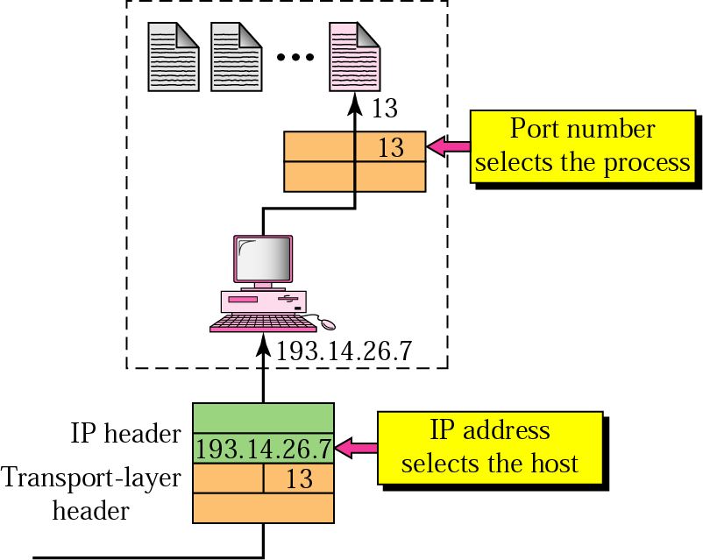
in all the above, a destination address is needed for delivery and a source address for reply (next node, destination host, and destination process, respectively)
IP addresses and port numbers play different roles
in the Internet model, the port numbers are 16-bit integers between 0 and 65,535
ephemeral port number: the client program defines itself with a port number, chosen randomly by the transport layer software running on the client

Slide 10
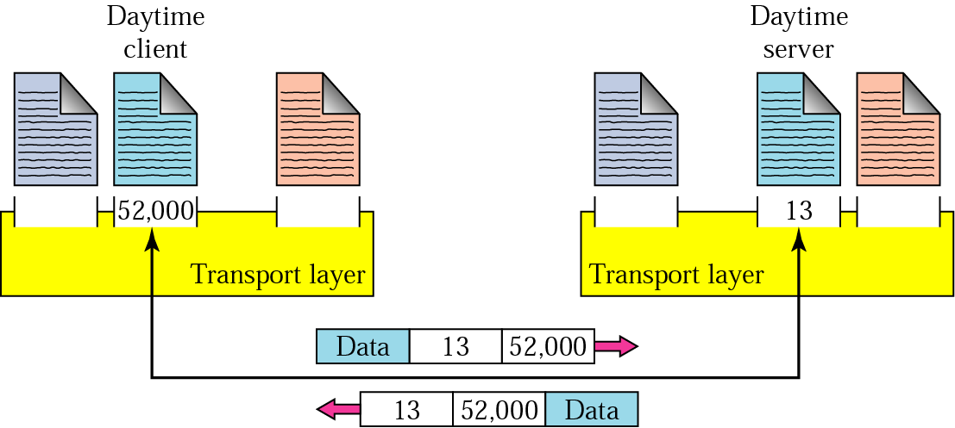
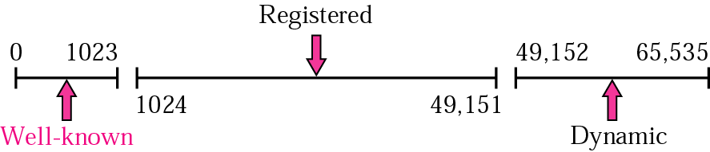
well-known port numbers: universal port numbers for servers; not random since a client process cannot know it
IANA (Internet Assigned Numbers Authority) Ranges
IANA divided the port numbers into three ranges
Well-known ports: assigned and controlled by IANA for standard services
Registered ports: are not assigned and controlled by IANA; can only be registered with IANA to prevent duplication
Dynamic ports: neither controlled nor registered; these are the ephemeral ports

Slide 11
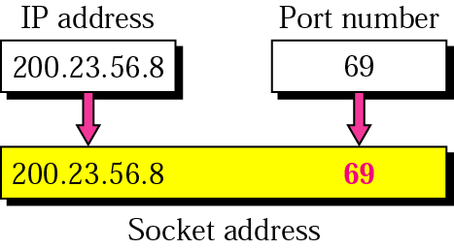
Socket Addresses
process-to-process delivery needs two addresses: IP address and port number at each end
the combination of an IP address and a port number is called a socket address
a transport-layer protocol needs a pair of socket addresses: the client socket address and the server socket address
the IP header contains the IP address; the UDP or TCP header contains the port number

Slide 12
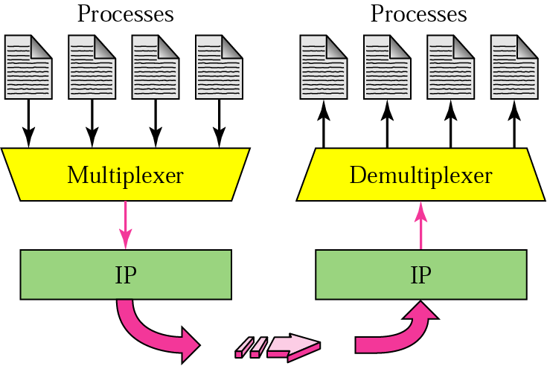
Multiplexing and Demultiplexing
the addressing mechanism allows multiplexing and demultiplexing by the transport layer since there may be several processes that need to send packets, but there is only one transport-layer protocol (UDP or TCP)

Slide 13
3.4 Connection Control
a transport-layer protocol can be either connectionless (UDP) or connection-oriented (TCP)
if connection-oriented, it first establishes a virtual connection, then follows data transfer, then the connection is terminated
3.5 Reliability - UDP and TCP
a transport-layer service can be either reliable or unreliable
the choice depends on the needs of the application layer program
a reliable transport-layer protocol (TCP) implements flow and error control; a slower and more complex service
if the data link layer is reliable and has flow and error control, do we need this at the transport layer?
yes; reliability at the data link layer is between two nodes, but we also need reliability between two ends
flow control at the transport layer is end-to-end rather than across a single link

Slide 14
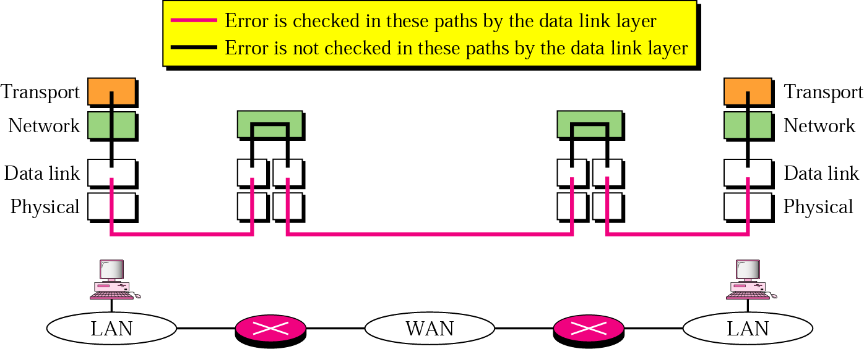
reliability may not be needed (UDP)
a process may use its own flow and error control mechanisms
a process may need fast service
the nature of the service may not demand flow and error control (real-time applications)

Slide 15
UDP - User Datagram Protocol
connectionless and unreliable transport layer protocol in the Internet (no flow or error control, no retransmission if data is corrupted or lost)
simple with a minimum of overhead
convenient for
multimedia and multicasting applications
for client-server situations
e.g., DNS can use UDP, give me the IP address of the host name www.cs.aau.edu.et - see later

Slide 16
some of the well-known ports used by UDP (see www.iana.org for a complete list - also for TCP ports)
Port | Protocol | Description
7 | Echo | Echoes a received datagram back to the sender
9 | Discard | Discards any datagram that is received
11 | Users | Active users
13 | Daytime | Returns the date and the time
17 | Quote | Returns a quote of the day
19 | Chargen | Returns a string of characters
53 | DNS | Domain Name Service
67 | Bootps | Server port to download bootstrap information
68 | Bootpc | Client port to download bootstrap information
69 | TFTP | Trivial File Transfer Protocol
111 | RPC | Remote Procedure Call
123 | NTP | Network Time Protocol
161 | SNMP | Simple Network Management Protocol
162 | SNMP | Simple Network Management Protocol (trap)

Slide 17
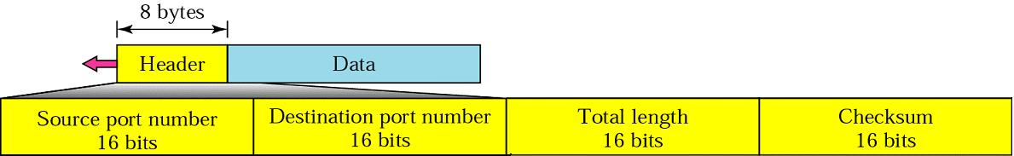
UDP packets, called datagrams, have a fixed size header of 8 bytes followed by the payload (data)
Checksum: optional; if not included, the field is filled with 0s (a true computed 0 is stored as all 1s)
Some Applications of UDP
for processes that require simple request-response communication; not for applications that send bulk data such as FTP
for a process with internal flow and error control mechanisms, e.g., TFTP (Trivial FTP)

Slide 18
for multicasting; multicasting capabilities are embedded in the UDP software but not in the TCP software
used for some route updating protocols such as RIP (Routing Information Protocol)
used in conjunction with RTP (Real Time Transport Protocol) to provide a transport-layer mechanism for real-time data; see later for RTP in the discussion of multimedia
TCP - Transport Control Protocol
reliable, but complex transport-layer protocol in the Internet
it is called a stream connection-oriented and reliable transport protocol
like UDP, TCP uses port numbers as transport-layer addresses
note: if an application can use both UDP and TCP, the same port number is assigned to this application; e.g., Daytime, DNS

Slide 19
some of the well-known ports used by TCP
Port | Protocol | Description
7 | Echo | Echoes a received datagram back to the sender
9 | Discard | Discards any datagram that is received
11 | Users | Active users
13 | Daytime | Returns the date and the time
17 | Quote | Returns a quote of the day
19 | Chargen | Returns a string of characters
20 | FTP, Data | File Transfer Protocol (data connection)
21 | FTP, Control | File Transfer Protocol (control connection)
23 | TELNET | Terminal Network
25 | SMTP | Simple Mail Transfer Protocol
53 | DNS | Domain Name Server
67 | BOOTP | Bootstrap Protocol
79 | Finger | Lookup information about a user
80 | HTTP | Hypertext Transfer Protocol
111 | RPC | Remote Procedure Call

Slide 20
Important issues (topics) to be covered for TCP
TCP Services
Numbering Bytes
Segments and the TCP header format
Flow Control
Error Control

Slide 21
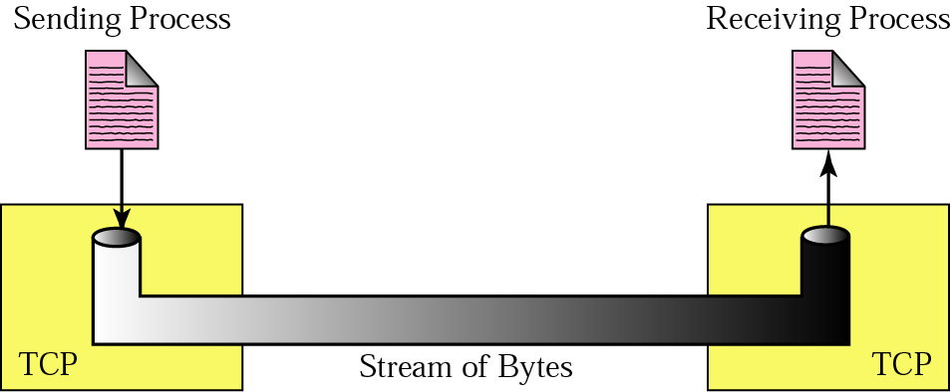
TCP Services
Stream Delivery Service
unlike UDP, TCP is a stream-oriented protocol; in UDP, there are no relationships between different chunks of data
in TCP, the two processes seem to be connected by an imaginary “tube” that carries their data across the Internet

Slide 22
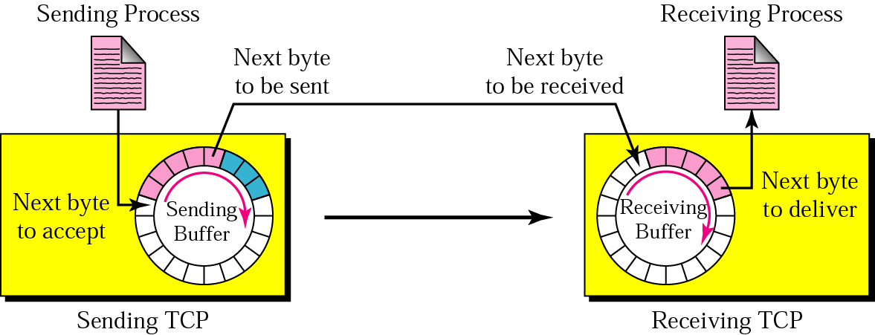
Sending and Receiving Buffers
the sender and the receiver may not produce and consume data at the same speed

Slide 23
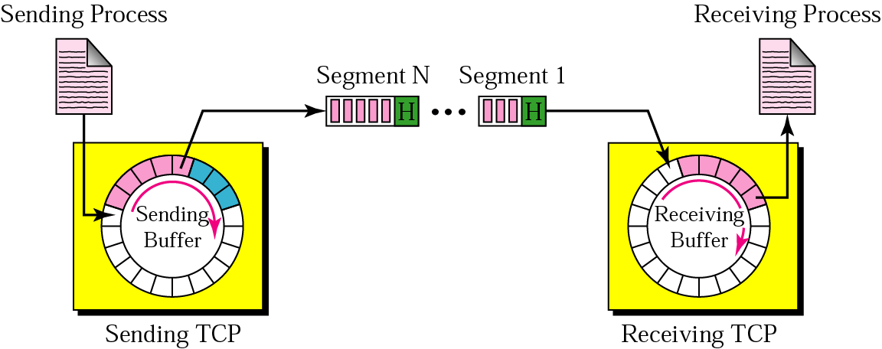
Bytes and Segments
the IP layer (as a service provider for TCP) needs to send data in packets, not as a stream of bytes
TCP groups a number of bytes together into a packet called a segment; it adds a header to each segment (for control purposes) and delivers it to IP

Slide 24
4. Full-Duplex Service
TCP offers a full-duplex service
each TCP has a sending and receiving buffer, and segments are sent in both directions
5. Connection-Oriented Service
a virtual connection for all segments belonging to a message is created
a TCP segment is encapsulated in an IP datagram and can be sent out of order, lost, or corrupted, and then resent
however, TCP creates a stream-oriented environment in which it accepts the responsibility of delivering the bytes in order to the other site
the connection is point-to-point (it has exactly two ends); TCP does not support multicasting or broadcasting

Slide 25
6. Reliable Service
it uses an acknowledgement mechanism to check the safe arrival of data (see later in error control)
Numbering Bytes
there are two fields in the TCP header: sequence number and acknowledgement number; they refer to the byte number not the segment number
Byte Numbers
TCP numbers all data bytes transmitted; numbering is independent in each direction; used for flow and error control
the numbering starts with a randomly generated number (between 0 and 2³²-1)
Sequence Number
after the bytes have been numbered, TCP assigns a sequence number to each segment
the sequence number is the number of the first byte carried in that segment

Slide 26
e.g., Imagine a TCP connection is transferring a file of 6000 bytes. The first byte is numbered 10,010. What are the sequence numbers for each segment if data are sent in five segments with the first four segments carrying 1000 bytes and the last segment carrying 2000 bytes?
The following shows the sequence number for each segment:
Segment 1 ==> sequence number: 10,010 (range: 10,010 to 11,009)
Segment 2 ==> sequence number: 11,010 (range: 11,010 to 12,009)
Segment 3 ==> sequence number: 12,010 (range: 12,010 to 13,009)
Segment 4 ==> sequence number: 13,010 (range: 13,010 to 14,009)
Segment 5 ==> sequence number: 14,010 (range: 14,010 to 16,009)

Slide 27
Acknowledgement Number
to confirm the bytes the receiver has received
it defines the number of the next byte that the receiver expects to receive (both can be receivers since the transmission is full-duplex)
it is cumulative; the receiver adds 1 to the number of the last byte it received correctly and announces this as the acknowledgement number
e.g., if a party uses 5643 as an acknowledgement number, it means that it has received all bytes from the beginning up to 5642 (does it mean it has received 5642 bytes?)

Slide 28
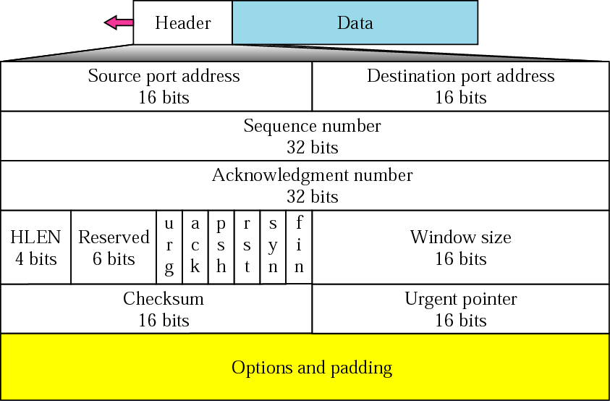
Segments
the unit of data transfer using TCP is a segment
a segment consists of a 20- to 60-byte header followed by data
Header length (HLEN): the number of 4-byte words in the TCP header (because of the options)
Control: 6 different control bits or flags; they enable flow control, connection establishment and termination, and the mode of data transfer in TCP
UDP Header
TCP Header

Slide 29
Flag Description
URG The value of the urgent pointer field is valid
ACK The value of the acknowledgment number field is valid
PSH Push the data; send it without waiting for the window to be filled
RST Connection must be reset - as a result of host crash or other reasons
SYN Synchronize sequence numbers during connection establishment
FIN Terminate the connection
Urgent pointer: the segment contains urgent data; it must be delivered soon even if out of order, e.g., Control-C to abort the application program on the other side; valid only if the urgent flag is set
Widow size: defines the size of the sliding window, in bytes, that the other party must maintain

Slide 30
Flow Control
defines the amount of data a source can send before receiving an acknowledgement from the destination; used to prevent a fast transmitter from overwhelming a slow receiver
two extreme cases
send 1 byte: extremely slow
send all the data: speeds up the process; but may overwhelm the receiver; + if some part of data is lost, duplicated, received out of order, or corrupted, the source will not know until all data have been checked by the destination
TCP defines a window (somewhere in between the above two extremes)
it sends as many data as are defined by the sliding window protocol

Slide 31
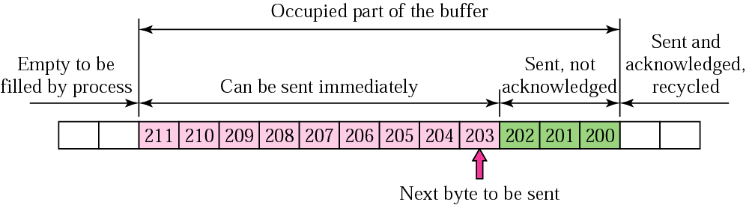
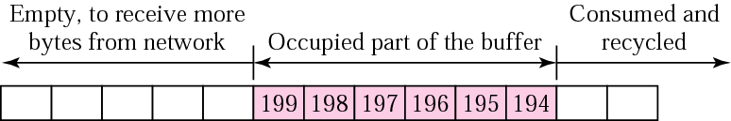
Sliding Window Protocol
both hosts use a window for each connection
used to make transmission more efficient as well as to control the flow of data so that the destination does not become overwhelmed
TCP’s sliding windows are byte-oriented
sender buffer (circular)
receiver buffer (circular)

Slide 32
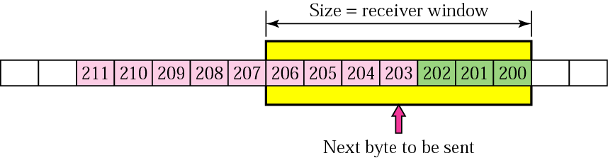
Receiver window
how many more bytes can the receiver store?
let N = the total size of the receiving buffer
M = the number of locations occupied
then only N-M more bytes can be received; this is called the receiver window; in the above example it is 13-6 = 7
Sender Window
we have flow control if the sender creates a window (the sender window) with a size less than or equal to the size of the receiver window
sender buffer and sender window

Slide 33
Error Control
error control in TCP includes mechanisms for detecting corrupted segments (discarded by the destination), lost segments (discarded by some intermediate node), out-of-order segments, and duplicated segments
most errors nowadays are caused by congestion rather than error-prone transmission media
it uses three simple tools: checksum, acknowledgement, and time-out
no negative acknowledgement is used in TCP; if a segment is not acknowledged before the time-out, it is considered to be either corrupted or lost

Slide 34
3.6 Congestion Control
they are related to three layers: data link, network, and transport layers
congestion: may occur if the load on the network is greater than the capacity of the network
it arises as a result of waiting (queues by routers)
when a packet is delayed, the source, not receiving the acknowledgement, retransmits the packet, which makes the delay, and the congestion, worse
congestion control: refers to the mechanisms and techniques to control the congestion and keep the load below the capacity; either prevent congestion before it happens or remove congestion after it has happened
(you can read more on the available techniques)

